Slide 1
Relationship Matters
Managing Your Emotions

Slide 2
Thoughts from Last Week
While Living Life from Inside Your Hula-Hoop this Past Week, did any Thought, Truth or Principle Stick in your Brain from Any Class We Have Had Together?
Did Anything Cause You to See Your Life and Your Relationships Differently? Did Anything “Make a Difference for You in Your Life?”
Did the Concept of the ”Emotional Fusion” Make Sense to You? Did You Get the Idea of What Kinds of Interactions “Glues” People Together?
Notes:
Remind the Class on Gravitational Pull.

Slide 3
Brief Review
We gaze, gather, collect and construct a self through the reflections of our selves from others. This self is a stable, consistent self, that we can trust and depend upon. True or False
At some point in our lives, a shift toward maturity must occur. We shift away from collecting, gathering and borrowing ourselves from others (and our surroundings) to shifting toward defining ourselves according to our higher values, which sometimes involves “going against the flow” of our normal self and others’ expectations. True or False

Slide 4
Brief Review
When alone, we seem to have a reasonably clear understanding of who we are. Yet, in the presence of a significant person (or persons), our understanding of who we are (our sense of self) is sometimes challenged. We have difficulty “holding onto ourselves.” True or False
We then are faced with a challenge, we confront ourselves and ask, “Is this my integrity standing up on its own two feet, or is it my self-justifying immaturity using this moment to appear mature?” True or False

Slide 5
The More Solid Your Relationship Core:
The More You Can:
Tolerate Differences
Love Somebody that is Different than You
Accept Others /Reality for Who They Are vs a Need/Protest to Change them for How You Wish Them to Be
Find Positive Value in Why You Do What You Do
Be More Active and Less Passive
Have Greater Confidence and Self-Esteem
Notes:
Remember: High and Low each Approach Concepts Differently!
Change your Words to:
Wish, Prefer, Desire, Want
Need, Demand, Require

Slide 6
Managing Your Emotional System
How the Brain and Body Creates Emotions

Slide 7
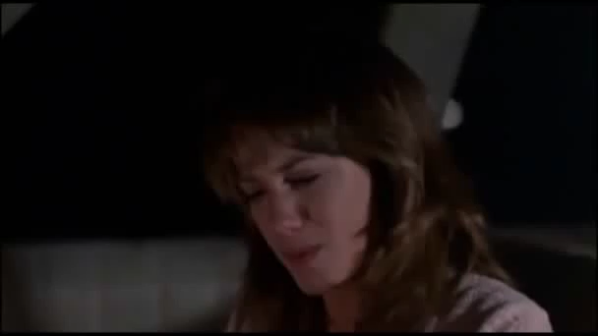
Edwina is Overcome with Emotion

Slide 8
A Thoughtful Question #1
Can You Trust Your Emotions?
Yes?
No?
Sometimes?

Slide 9
The A,B,C’s of Emotions
A + B = C
We Become Aware Emotions
We Feel Affected Feelings
Hula-Hoop Vibrates Actions
Something Matters Behaviors
We Naturally Think that “A” Causes “C.”
We say, “You Made Me So Angry!”

Slide 10
Epictetus: The Stoic, 55 A.D.
The appearance of things to the mind is the standard of every action to man.
In a word, neither death, nor exile, nor pain, nor anything of this kind is the real cause of our doing or not doing any action, but our inward opinions and principles.
What disturbs men’s minds is not events but their judgments on events. What distresses him is not the event, for that does not distress another, but his judgment on the event.

Slide 11
Epictetus the Stoic
Practice then from the start to say to every harsh impression, "You are an impression, and not at all the thing you appear to be." Then examine it and test it by these rules you have, and firstly, and chiefly, by this: whether the impression has to do with the things that are up to us, or those that are not; and if it has to do with the things that are not up to us, be ready to reply, "It is nothing to me.”
(This is called, “De-Construction”)
Notes:
In Greek: A Fantasia – a Fantasy

Slide 12
The A, B, C’s of Emotions
A + B = C
We Become Aware Our Belief Consequences
We Feel Affected Our Interpretation Emotions
Hula-Hoop Vibrates Our Perception Feelings
Something Matters Our Glasses
Assigned Meaning Actions
Story We Tell Ourselves Behaviors

Slide 13
The Brain Constructs and Simulates
The Brain takes in Data from the Senses. It “Sees” or “Hears” Something. “Sensations” are Experienced.
The Brain seeks to Make Sense of this Present Data by Drawing upon a Data Bank of Past Learned Experiences to Give Possible Meaning to the Present.
The Brain Selects a Past Learned Experience (an Attractor – a Concept) and Links it to the New Present Experience (Constructs and Simulates) so as to Understand (Interpret, Give Meaning to) the New Present Experience.
The Process is called, “Simulation.”

Slide 14
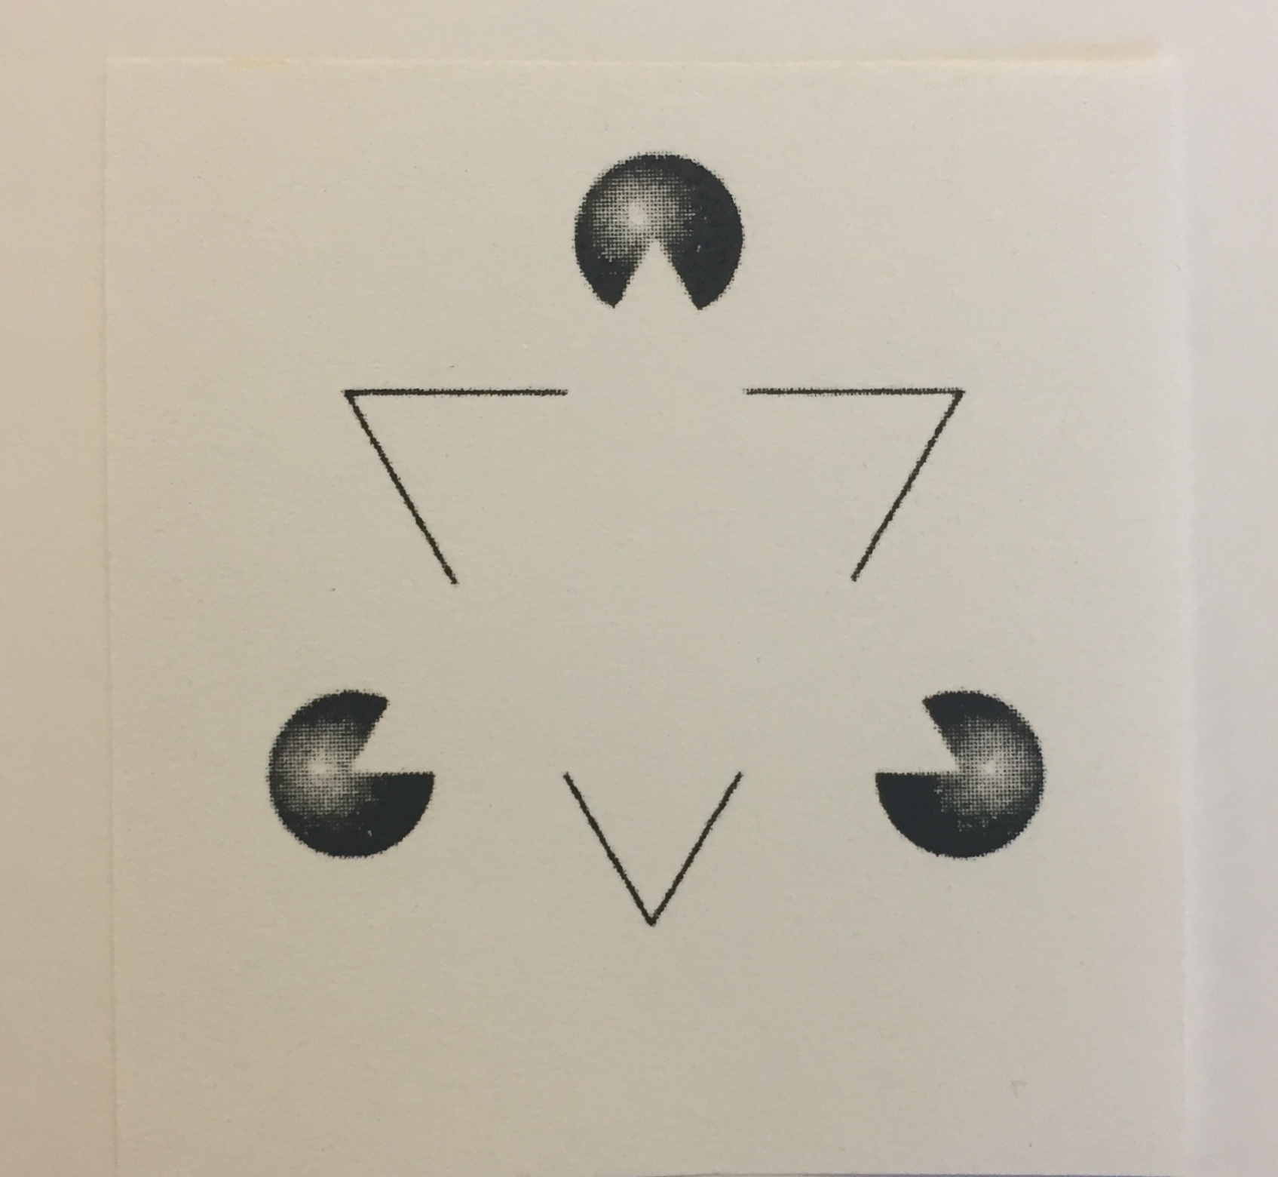
The Brain Constructs and Simulates
Notes:
Now – Try to ”See” what is really there, not your Brain’s Interpretation.
De-Construct the Lines and Images to only see Lines and Images and not Triangles!
The Brain is “Forcing” the lines and Images into a previous Template. It’s “wanting” to go there!
It is a Google Search Engine completing your Sentences from the few Words you type!

Slide 15
The Brain Constructs and Simulates
What we See, Hear, Touch, Taste, Smell and Feel are Simulations of the world, Constructed by our Brain, not “Reactions” to the world (both external and internal).
Simulations are our Brain’s Best Guess as to what’s happening in the World and in our Body.
Every waking moment, our Brain uses Learned Concepts (Attractors) to Simulate our External and Internal world. Without these, we are Experientially Blind.
Physical Sensations in our body have no Meaning until our Brain assigns a Meaning to them! This includes our Emotions. Our Brains Construct Our Emotions.

Slide 16
The Brain Constructs and Simulates
The Advantage:
The Brain’s use of Learned Concepts enables us to move through life with speed and quickness. It is a Google Search engine, quickly completing the sentences we type.
The Disadvantage:
The Brain’s use of Learned Concepts mean that past experiences misinform (blur) the present and new experiences in the present misinform (blur) the past.

Slide 17
The Brain Constructs and Simulates
Due to how the Brain learns, we are predisposed to be more aware of what we have already seen, hear anew what we have heard most often, think what we have always thought, and feel what we have mostly felt.
The sine qua non of a neural network is its penchant for strengthening neuronal patterns directly in proportion to their use. The more often we think, feel or imagine a thing, the more probable it is that our mind will revisit its prior stopping point.
It Interprets According to Context, Just Like the Meaning of a Word is nothing apart from its Context.
Notes:
When the circuits are sufficiently well worn such that thoughts fly down them with little friction or resistance, the mental path has become a part of you: A habit of speech, thought, action, attitude or feeling.
Sine Qua Non
The essential, crucial, or indispensable ingredient without which something would be impossible: From Latin, meaning “without which nothing.”
“E Pluribus Unum, my friends. Sine Qua Non!”
Andrew Jackson
“In scientific work, we find that the new theories are understood only by the graduate students, whose intellectual identities are wholly transformed.
In contrast, the senior professors are burdened with such connectional inertia that when they encounter new ideas there is no apparent effect, other than an occasional vague irritation.

Slide 18
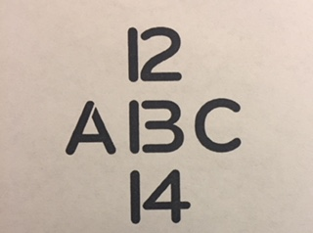
The Brain Constructs and Simulates

Slide 19
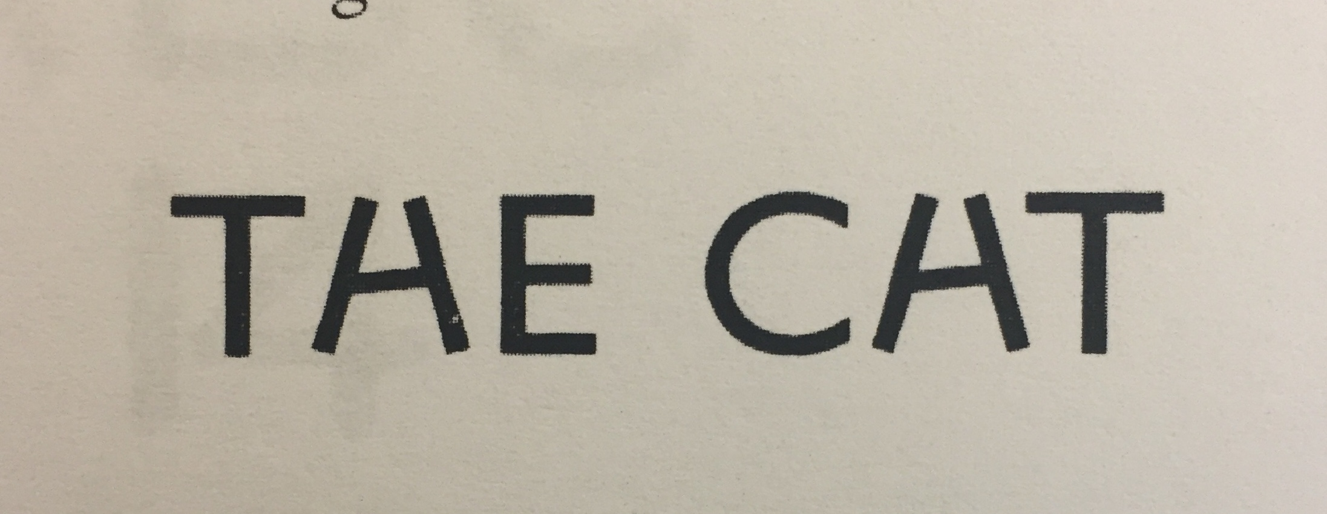
The Brain Constructs and Simulates

Slide 20
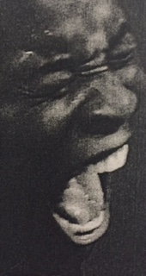
The Brain Constructs and Simulates

Slide 21

The Brain Constructs and Simulates

Slide 22
The Brain Constructs and Simulates
An Emotion (a Feeling) is our Brain’s best, speedy Construction/Interpretation/Creation of our Body Sensations and Behaviors, in relation to what is happening around us. Our Brain draws from previously learned Emotional Categories to Interpret the Present.
Our Brain Interprets in relationship to Perceived Context. Our Body Sensations and Behaviors in one Context produce an Emotion relative to that Perceived Context. The same body sensations in another Context, can produce completely different Emotions!

Slide 23
The Brain Constructs and Simulates
Emotions are not “Triggered.” They are “Active Constructions,” drawn from a Data Bank, of which We are Active Participants in that Construction! Our Brains are “Predicting” and “Forecasting,” Interpreting the Event Contextually and then Choosing a Concept.
The more we Link a Sensation in our Body and Behavior with an Emotional Concept, the Stronger the Neuropathway and the Quicker the Brain will Link to that Emotional Concept (Attractor)! The More You Feel it, the More You Will Feel it.

Slide 24
“Cause” versus “Construct”
Events Do Not “Cause” or “Create” What’s Inside Each of Us.
Events Stimulate, Evoke, and Reveal What is Already Inside Each of Us. Every Person’s Brain Creates Meaning. Every Person’s Brain “Fills the Gap” and Creates Meaning by Pinging back and Selecting its most Similar Concept.
We Can Learn a Great Deal About Ourselves (less about Reality) by Whatever Emotions We May Experience.

Slide 25
You Feel What Your Brain Interprets
A person’s cognitive interpretation of the physiological changes in their body and behaviors determines what they feel and what they experience.
Feelings are the result of the brain’s appraisal of an emotional neurological (your body) state. This appraisal is influenced by one’s situational context, cognition (categories of past learned experiences your brain draws from) and behaviors.

Slide 26
Managing Emotions
What to Do and What Not to Do

Slide 27
How We “Use” Emotions
When We Experience an Emotion, Our Automatic Assumption is that Something External is the “Cause” of the Emotion.
“What YOU Did (or Didn’t Do) or Said (or Didn’t Say) Caused Me to Feel this Way!”
Naturally, When Viewed this Way, “Fault and Blame” are Assigned to the External Stimulus.
“It’s Your Fault I Feel this Way! You are to Blame!”

Slide 28
How We “Use” Emotions
We then Absolve Ourselves of any Personal Responsibility because We are Blaming the Stimulus.
The Emotion that We are Experiencing then Becomes Our Self-Justifying Motivation for Doing Something, i.e. Our Actions and Behaviors.
“I have a Right to Act the Way I’m Acting Because You Made Me Feel the Way I Feel!”

Slide 29
How We “Use” Emotions
We Create a Self-Serving, Self-Justifying Story, Exonerating Ourselves of Any Personal Responsibility. This Story is not About Facts or Truth, but About a Goal or Purpose We Have and Choose to Construct.
Thoughts, Emotions and Actions then Reify Each Other, Reinforcing and Solidifying a ”Reality” We Create!

Slide 30
How We “Use” Emotions
Perceptions/Interpretations
Actions/Behaviors Emotions/Feelings
Each of These Strengthen Each Other and Create a Self-Serving, Unexamined, Closed-System
“My Way of Perceiving and Interpreting is the Right Way!”

Slide 31
How We “Use” Emotions
We then Use Our Emotions to Take Front and Center Stage in the Story We Wish to Tell, for an End Goal We Wish to Justify. What We Feel and Experience Now Becomes the Focus! Emotions now Drive Our Behaviors!
“I’m Just Telling You What I Feel!”
We Share Our Emotions to Influence, Correct and Change Others! We Want Others to Take Personal Responsibility for Our Emotions, i.e. What We are Experiencing!

Slide 32
How We “Use” Emotions
When We Emotionally Invest in Our Own Story, Our Own Created Reality, Disconfirming Data (Logic, Facts, Other Perspectives) Will Not Penetrate!
Logic (facts) cannot Displace an Idea that was NOT Originally Placed there by Logic.
We are then Prone to Only “See” that Which Proves or Confirms What We Already “See.”
Confirmation Bias

Slide 33
Principle #6
In order for a problem to have a chance to become the problem, don’t you or your responses become the problem.
What’s the real issue: You and your emotional responses to the issue? Or the issue?
What do you want the focus to be?
Are you trying to find a solution? Or do you simply want to make it “personal?”

Slide 34
Principle #7
We are each responsible for our response to the problem.
There is the “problem” and then again, there is our response to the problem.
Our emotional response does not necessarily change “reality.” If our emotional response does bring about change, we may have to continual having the emotional response in order to sustain the change that has been created.

Slide 35
Emotional Flexibility
Observe and Describe the Event Prompting the Emotion, i.e. the Trigger.
Identify the Interpretations of the Event that Prompted the Emotion, i.e. the “Belief” Factor.
Observe and Describe the Actual Experience, including the Physical Sensation of the Emotion. Be “Clinical.”
Observe and Describe the Expressive Behaviors associated with the Emotion.
Observe and Describe the After Effects of the Emotion on Your Functioning.

Slide 36
Important Ideas
Your Identity and Your Emotions are not the Same Thing. You are Not Your Emotions.
Emotions are Usually Shared in order to Influence, Persuade and Change Others.

Slide 37
Irresponsible Sharing
“I feel this emotion and you caused it! It’s all your fault that I feel what I feel.”
“What you did hurt me. I’m just sharing what I feel!”
“My emotion is REAL and it tells me about YOU!”
It is interesting how “personally felt emotions” begin to take the forefront in a person’s story. This is simply a self-justifying platform to influence and change the other person or persons. The “problem” is external, so the “solution” is believed to be external.

Slide 38
A Thoughtful Question
When is it “Right” to Share Your Emotions?
Ask Yourself:
“What is the Purpose of Sharing What You are Feeling and Experiencing with Your Spouse (or Someone Else)?”
“What Do You Want to Happen as a Result?”

